Slide 1
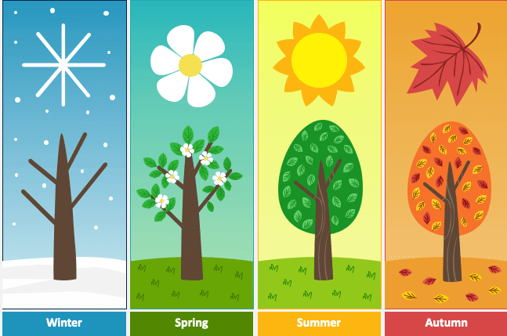
Answer the questions. What can you do in …?

Slide 2
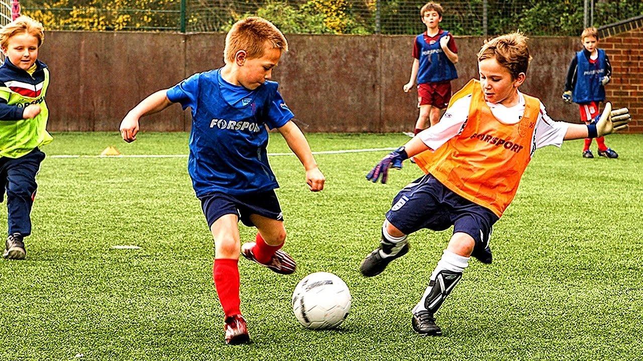
What can you do in spring?

Slide 3
I can play football in spring.

Slide 4
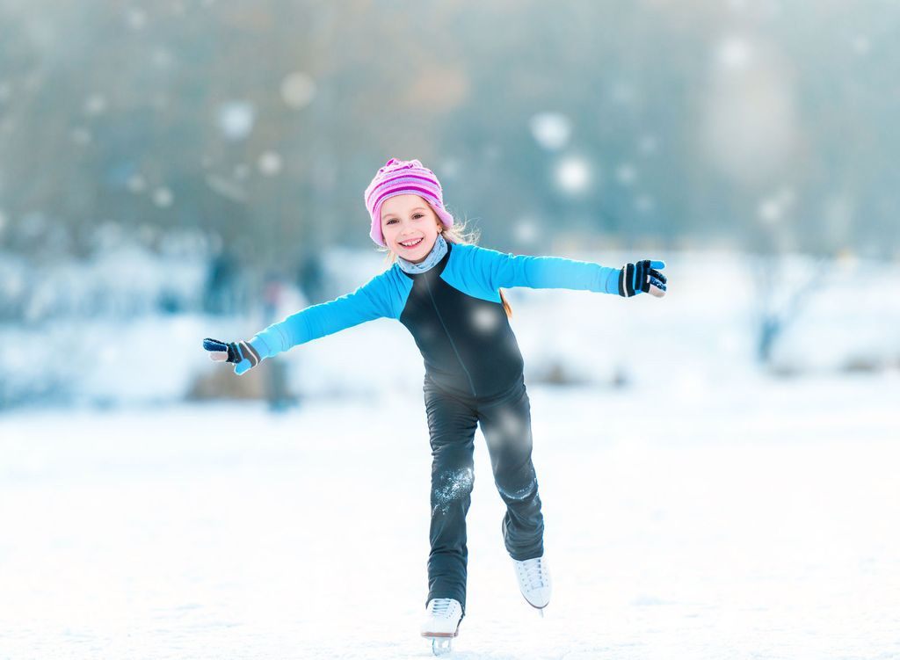
What can you do in winter?

Slide 5
I can skate in winter.

Slide 6
What can you do in spring?
and

Slide 7
I can dance and sing in spring.
and

Slide 8
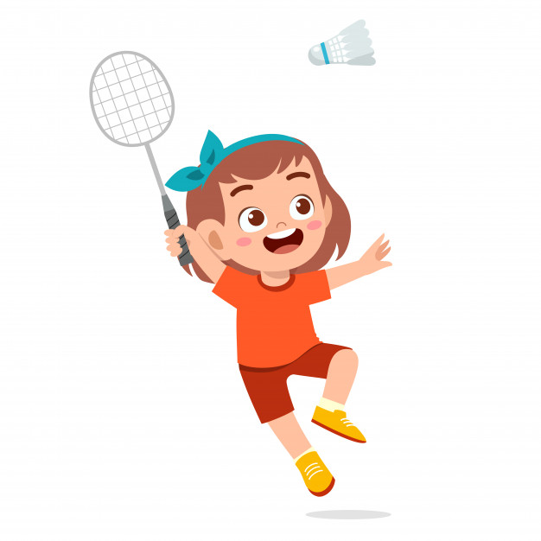
What can you do in summer?

Slide 9
I can play badminton in summer.

Slide 10
What can you do in winter?

Slide 11
I can ski in winter.

Slide 12
What can you do in autumn?

Slide 13
I can play basketball in autumn.

Slide 14
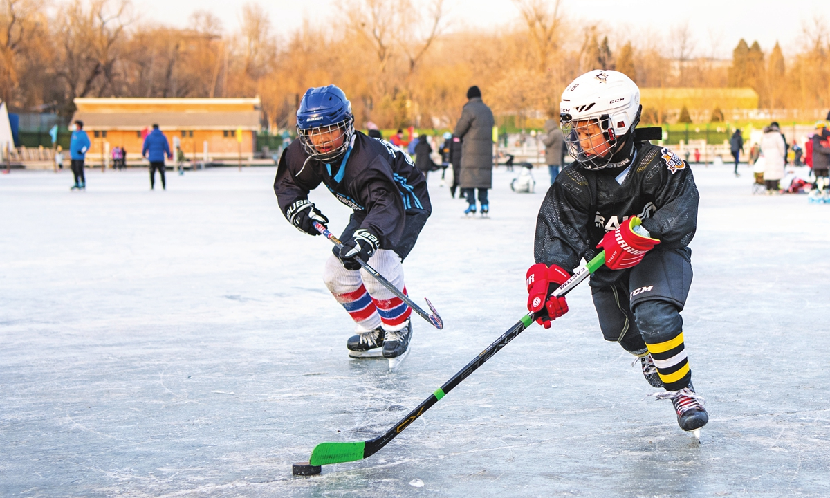
What can you do in winter?

Slide 15
I can play ice-hockey in winter.

Slide 16
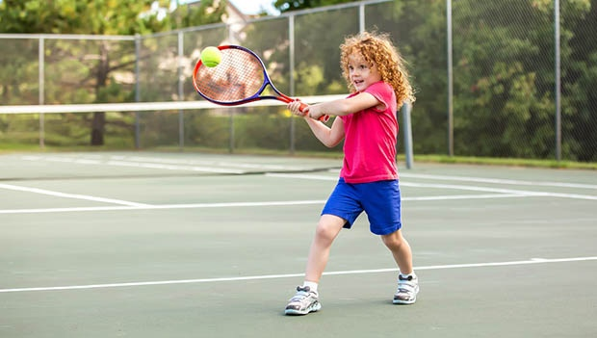
What can you do in summer?

Slide 17
I can play tennis in summer.

Slide 18
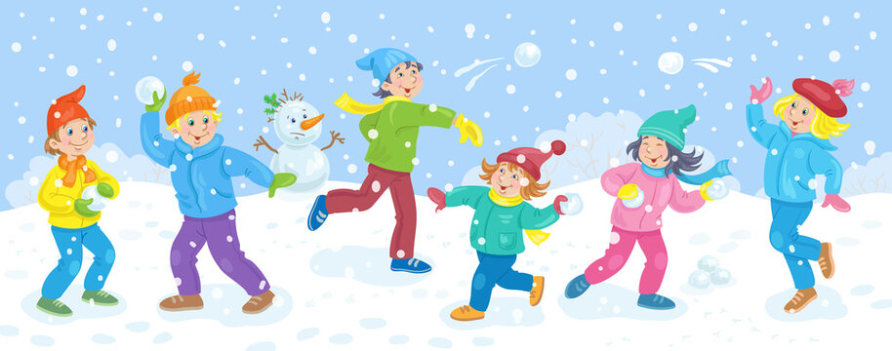
What can you do in winter?

Slide 19
I can play snowballs in winter.

Slide 20
What can you do in summer?

Slide 21
I can play volleyball in summer.

Slide 22
Thank you for the answers! =)

